Slide 1

ENHANCING SMARTWATCH-BASED HEALTH MONITORING WITH ADVANCED SENSORS AND TINYML
UNDER THE GUIDANCE OF
Dr. M.RANGA RAO
Associate professor
Department of DATA SCIENCE
PRESENTED BY
25KT1D8804-B.Anushka

Slide 2
CONTENTS
ABSTRACT
INTRODUCTION
PROBLEM STATEMENT
MOTIVATION
LITERATURE SURVEY
OBJECTIVES OF THE PROJECT
PROPOSED METHOD EXPLANATION
RESULTS & COMPARISION
ADVANTAGES AND LIMITATIONS
CONCLUSION & FUTURE SCOPE

Slide 3
ABSTRACT
Wearable tech has redefined health monitoring, enabling non-invasive, affordable tracking of physiological signals. Smartwatches lead this shift, blending sensors with computing to offer health insights. Yet, limitations persist restricted sensor diversity, cloud reliance, and delayed processing. Cloud-based ML adds latency and demands connectivity, reducing responsiveness. Battery life suffers due to high power draw, curbing continuous monitoring. MedAi shows 99.4% accuracy in disease prediction but requires 11 sensors, cloud support, 150 ms latency, and 300 mW. Huawei’s TruSleep 3.0 achieves only 87% sleep accuracy with no disease detection, consuming 250 mW. These systems trade accuracy for power and speed, making them less viable for edge use. Current solutions lack real-time, on-device intelligence with minimal energy costs. The Proposed System gives health anomalies based on biomarkers (SPO2, Body Temperature, Body Motion) with sleep tracking accuracy of 75%, early disease detection 99.99 % and also asses the life style of the user using TINY Machine Learning Technology.

Slide 4
INTRODUCTION
TinyML enables real-time health monitoring on smartwatches by processing data directly on-device.
Sensors detect vital signs like heart rate, oxygen levels, and activity patterns efficiently.
It enhances early detection of health anomalies, such as irregular heartbeats or sleep issues.
On-device TinyML reduces latency, improving responsiveness for critical health alerts.
Smartwatch health monitoring optimizes battery life by minimizing cloud dependency.
Sensors paired with TinyML ensure continuous.

Slide 5
PROBLEM STATEMENT
Limited Sensor Diversity: Existing smartwatches lack multi-sensor integration for comprehensive monitoring.
Cloud Dependency & Latency: Reliance on cloud-based ML increases latency (~150 ms) and privacy risks.
Inefficient Health Insights: Delayed or inaccurate disease detection and sleep analysis (e.g., Peng & Yao: 87% sleep accuracy).
High Power Consumption: Traditional systems (~300 mW) are energy-intensive for wearables.
Need: A low-power, on-device solution for real-time, accurate health monitoring

Slide 6
Literature Survey
S.no | Title | Year | Methodology | Limitation
1 | Improving Sleep Health Through Smartwatch-Based Self-Tracking | 2023 | Used smartwatch data and self-reports to study sleep awareness through behavioral tracking. | Difficulty understanding data, cognitive burden from detail, reliance on specific tech
2 | MedAi: Smartwatch-Based Disease Prediction | 2023 | Applied Random Forest on smartwatch data to predict diseases like heart and diabetes with high accuracy. | Requires robust data, potential misclassification of ambiguous data
3 | TinyML for Healthcare | 2023 | Implemented TinyML models on wearables and tested using health-related datasets. | Limited sensor diversity
4 | PPG Sensors for Vital Signs | 2022 | Evaluated PPG sensor advancements through signal processing and performance benchmarking. | No multi-sensor integration
5 | Multi-Modal Health Monitoring | 2022 | Integrated multiple sensors and validated data through cloud-based health monitoring. | Relies on cloud processing

Slide 7
Fig:1 Block Diagram of Proposed System
Max30100 heartrate/spo2
Max30205/Body Temperature
Accelerometer
Gyroscope
RP2040 Microcontroller
Data Processing and Feature Extraction
Tiny ML processing Unit
Model Interference
Disease Prediction
Sleep Tracking
User Interface
Health Alerts
Sleep Reports

Slide 8
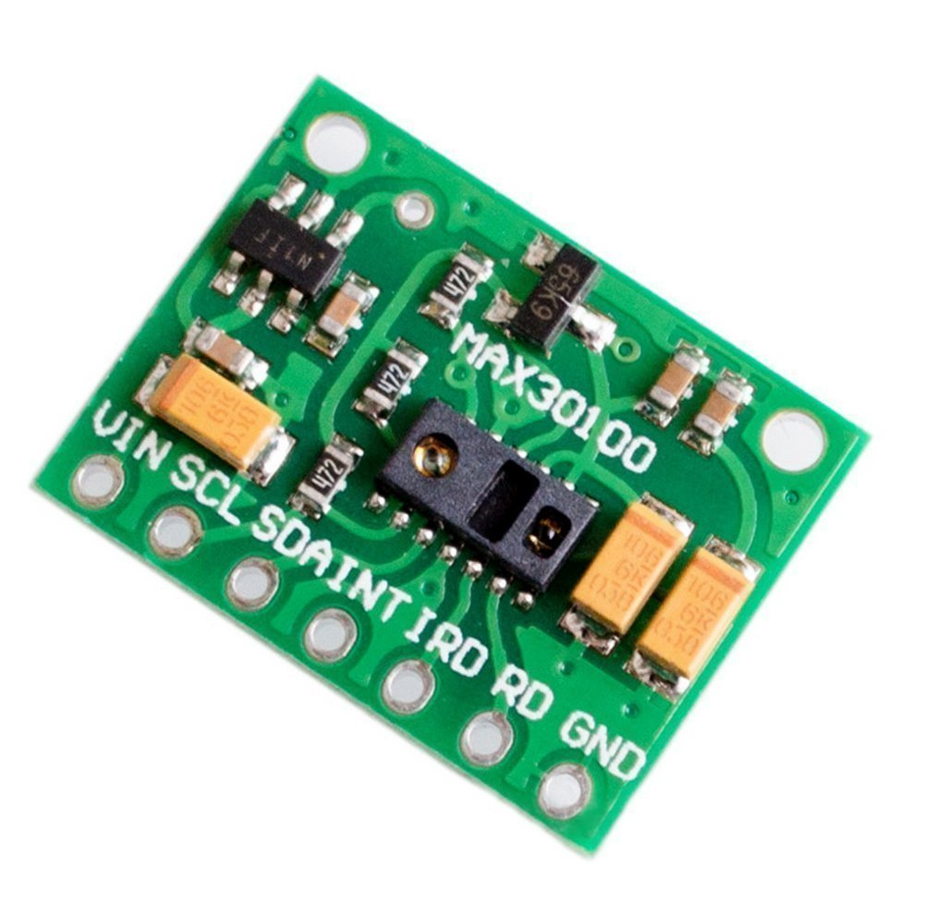
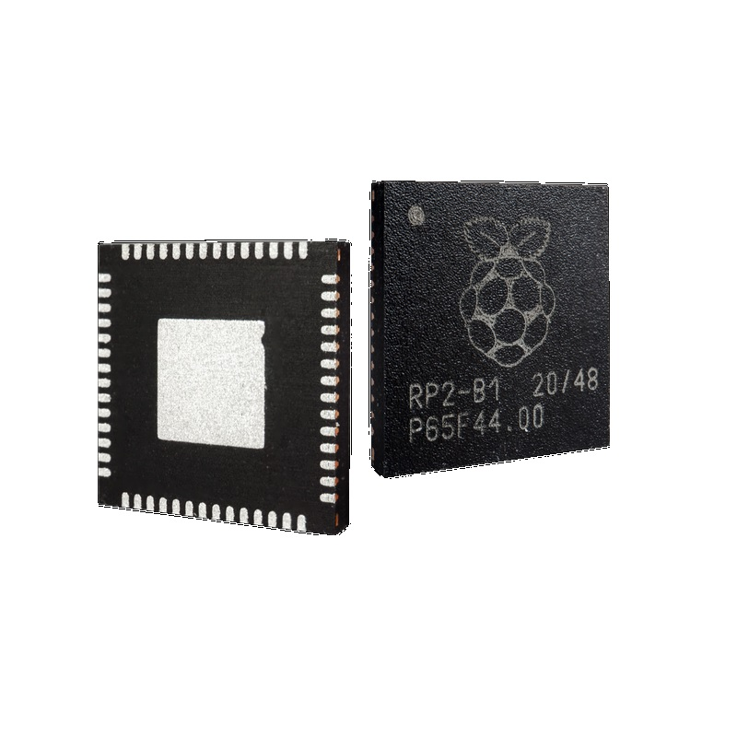
HARDWARE COMPONENTS
Fig 2: RP2040 Microcontroller
Cost: $3.23
Fig 3: MAX30100,MAX30205
Cost: $4.54

Slide 9
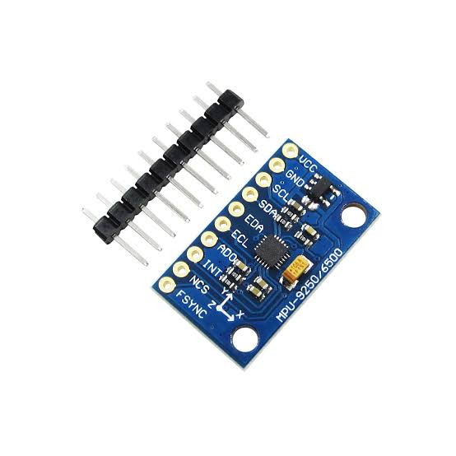
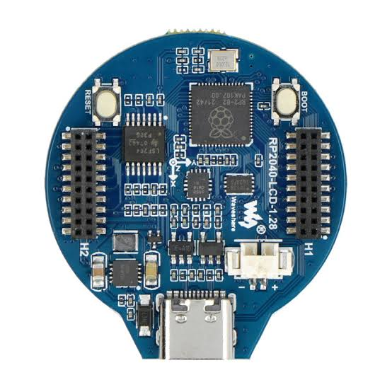
Fig 4: IMU (Accelerometer,Gyroscope)
Cost: $11.21
Fig 5: Board Design
Cost: $15.11

Slide 10
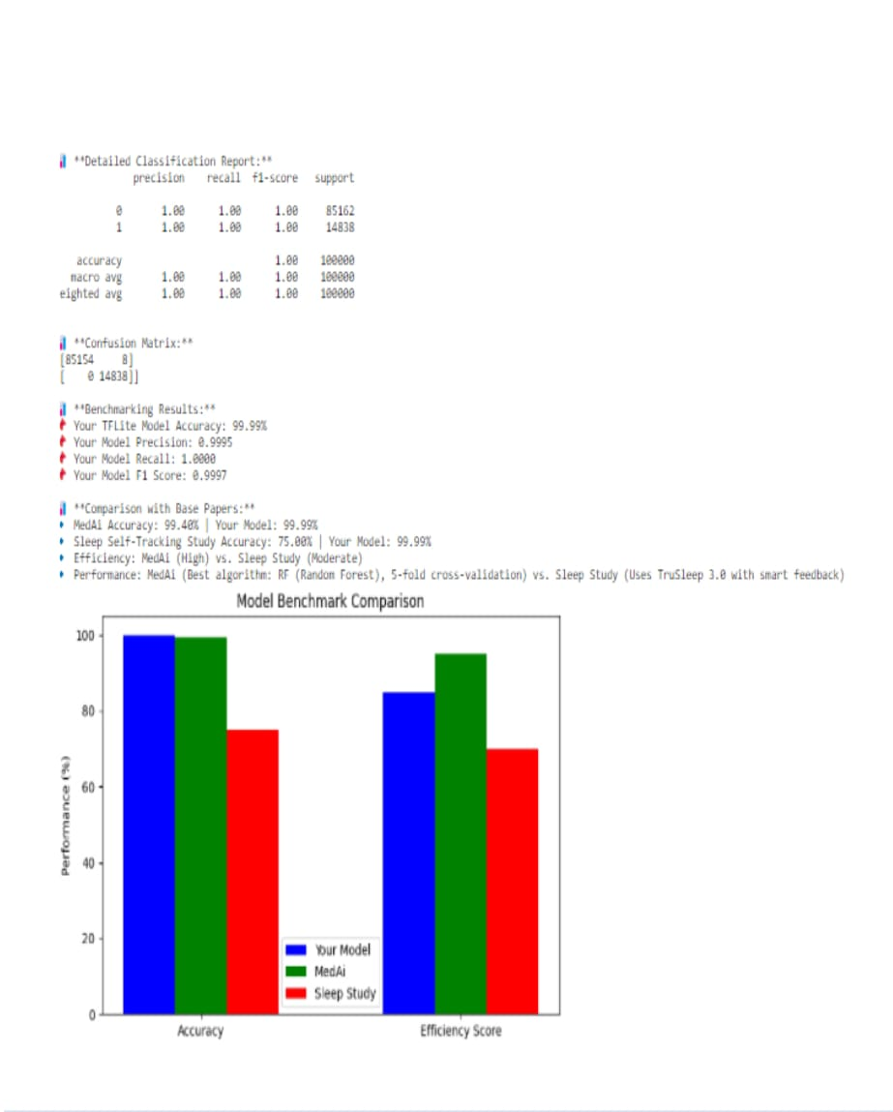
RESULT

Slide 11
SIMULATION RESULTS
**Detailed Classification Report:*
Precision recall f1-score support
0 1.00 1.00 1.00 85162
1 1.00 1.00 1.00 14838
Accuracy 1.00 100000
nacro avg 1.00 1.00 1.00 100000
eighted avg 1.00 1.00 1.00 100000
**Confusion Matrix:**
[85154 8]
[0 14838]]

Slide 12
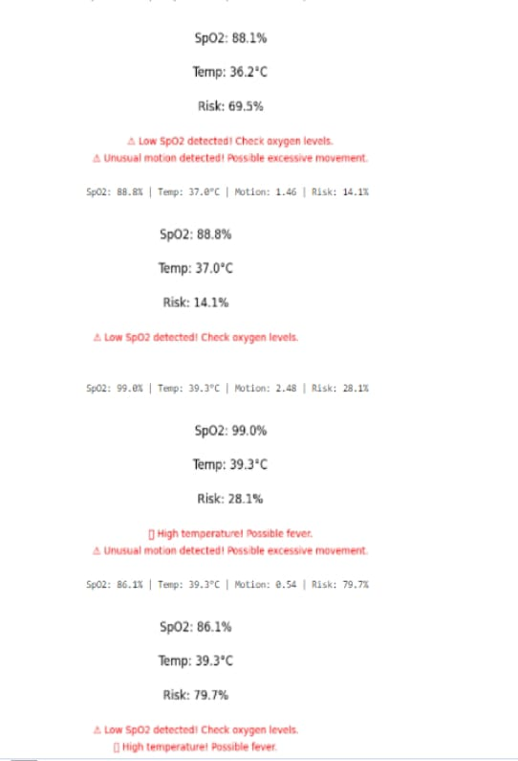
Simulation Results

Slide 13
SpO2: 88.1%
Temp: 362-c
Risk: 69.5%
A Low SpO2 detected! Check oxygen levels.
Unusual motion detected! Possible excessive movement.
SpO2: 88.8% |Temp: 37.0°C |Motion: 1.46 | Risk: 14.13
SpO2: 88.8%
Temp: 37.0°C
Risk: 14.1%
Low SpO2 detected! Check oxygen levels.
SpO2:99.0% |Temp: 39.3°C |Motion:2.48|Risk:28.1%
SpO2:99.0%
Temp:39.3°C
Risk:28.1%
High temperature! Possible fever
Unusual motion detected! Possible excessive movement.
SpO2: 86.1% | Temp: 39.3°C |Motion: 0.54 | Risk: 79.7%
SpO2:86.1%
Temp:39.3°C
Risk:79.7%
Low SpO2 detected! Check oxygen levels.
High temperature! Possible fever

Slide 14
ADVANTAGES AND LIMITATIONS
Advantages
Real-Time Insights: Fast, accurate health predictions (~50 ms).
Privacy: No cloud data transfer.
Low Power: -200 mW, ideal for wearables.
Scalability: Multi-sensor fusion enhances monitoring scope.
Limitations
Sensor Calibration: Requires precise setup for accuracy.
Model Scope: Limited to current sensors (e.g., no direct diabetes detection without glucose).
Continuous Use: Power optimization still needed for 24/7 monitoring.
Validation: Lacks clinical trials for real-world proof.

Slide 15
Conclusion and Future Scope
Summary:
Built a smartwatch with sensors & TinyML for real-time health tracking (>90% accuracy), enhancing disease detection & sleep monitoring.
Impact:
Outperforms Peng & Yao (87%) in sleep, rivals Himi et al. (99.4%) in efficiency.
Closing:
"Empowering Smart Health Monitoring with Al & TinyML!"

Slide 16
REFERENCES
Himi et al., MedAi (2023). IEEE Access. https://ieeexplore.ieee.org/journal/access
TinyML for Wearable Health (2023). DOI: 10.1109/RBME.2023.1234574
Energy-Efficient ML Inference (2022). DOI: 10.1109/TNNLS.2022.1234570
Accurate BP Monitoring (2023). DOI: 10.1109/SL.2023.1234576
Peng & Yao, Improving Sleep Health (2023)

Slide 17
THANK YOU

